Slide 1

Mercury Package Manager
Jacob Boers Emily Costa Ben DeVries | Andrew Feikema Coleman Ulry Jack Westel

Slide 2
Our Vision
Streamlining dorm delivery for Calvin University
Simple, fast interface for logging packages when they arrive
Notifications for residents when their packages are logged
Easy search of package log when resident picks up their package
Notes:
The Mercury Package Management app seeks to provide a simple and hassle-free platform for managing deliveries for Calvin’s Residence Halls and notifying the intended recipients. Online shopping is the primary method of purchasing items for many students, especially for those who don't have cars, and even more so during the COVID-19 pandemic. All packages for Calvin's campus arrive at mail services where they are sorted and delivered to the building of its recipient. From there, it is up to the dorms' deskies to sort and log each package, notifying the recipient that it is available to pickup.
Currently, dorm deskies keep track of packages using a Google Sheets spreadsheet. This table keeps track of the recipient, their room number, the date the package arrived, and a description of the package. Deskies then notify the recipients over email that their package has arrived. This manual submission process can be rather slow, especially at certain times of the year when packages are filing in quickly, such as move-in week. We have heard stories where packages could be not picked up by their recipients on the day the were delivered because the deskie could not sort them in a timely fashion before their shift was over. Our hope is that automating this system will speed up the sorting process and get the packages into the hands of the recipients more efficiently.
Mercury Package Management will improve this process on two fronts: the deskie interface and the recipient interface. Deskies will be able to quickly enter package information with the assitance of automation from the app, and recipients will be able to view packages that are available for pickup. Instead of relying on a spreadsheet that has no quick way to lookup and enter data, a database will be used to store package information and status, as well as information about the building's current residents.

Slide 3
UI Design
Simplicity
Puts the deskie in control
Calvin color theme
Consistent fonts and button styles
Real-Time Open/Close
Notes:
Bottom line: we wanted to keep the UI design simple. We saw no real value or advantage in making the UI complex, as complexity will just confuse deskies and residents, and our hope in making this app is to simplify the package entry and pickup process. Our UI puts the deskie in control of the app, as they have several routes to take depending on what they trying to accomplish when they log in. As this is an app we hope to deploy to calvin residence halls, we used calvin maroon, Furthermore, our buttons and fonts are consistent and universal, which we hope would make the user feel comfortable within the app. Lasly, for me, i never knew whether or not the desk was open or closed for me to pick up my package. To combat this, our app will tell you, real time, whether or not the desk is currently open, saving some trips up and down the stairs.

Slide 4
User Experience
What do we want users to do?
What’s the first thing they should see?
What options should be made available first?

Slide 5
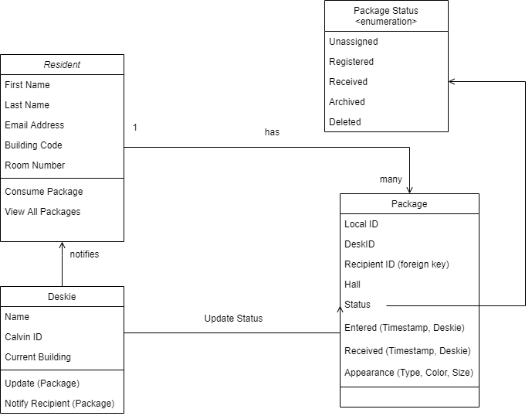
Information System
Residents & Package
Query by ID sent to resident
Allows for efficient queries (by date, recipient, appearance, status)

Slide 6
API Queries
Get people/person:
[{"emailprefix": "ajf34", "firstname": "Andrew", "lastname": "Feikema", "residenthall": "SZ", "residentroom": "268", "deskcode": "SE", "persontype": "Resident"}...]
Get package(s):
[{"id": 1, "deskid": 104, "recipient": "ajf34", "building": "SE", "status": "Archived", "enteredtime": "2020-10-21T14:03:12.000Z", "entereddeskie": "bjd47", "receivedtime": "2020-11-01T18:03:24.000Z", "receiveddeskie": "bjd47"}...]

Slide 7
Status Report
UI
Going Forward
Database Connection
Security
Notes:
Status: UI is fully complete for the most part. The only UI tweaks left are for when we get the app to connect to the database so we can actually display the information. Going forward we have two big things to work on. First is making sure the app connects to our database so we don’t need to hard code in packages like in the demo. The second thing to look towards is Security on the app. Right now any old person can access the Deskie portal by typing the username “deskie”. Typing literally anything else will send you to the resident screen.

Slide 8
Questions?

